Slide 1


Python For Data Science Part 1
NumPy, Pandas and Matplotlib
Exploring core libraries
bit.ly/python_git
(code)

Slide 2


Upcoming Events
Terminator Film Night
Thursday 24th of October
Exact details to be determined…
Public Talk
From a founder of Sentient Machines
Exploring her journey as a founder and technology behind the project
27th of November, 17:00 in Diamond

Slide 3
Accessing the Code
There are two options for accessing the code:
Trough GitHub page which can be found here: bit.ly\python_git
Using Google Colab – we will provide one link at a time: Here is a link to NumPy notebook: bit.ly/python_numpy

Slide 4


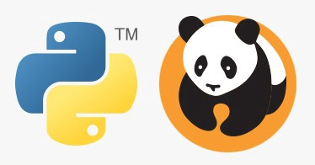

Contents
In this workshop we will cover:
Jupyter Notebook
NumPy
NumPy Arrays and Attributes
UFunc and Broadcasting
Data Aggregation
Pandas
Pandas Data Structures (Series and DataFrame)
Importing data
Cleaning data using Pandas
Matplotlib
Plotting Hierarchy
Different Interfaces
Simple Plots
Iris Flower Data Set Exercise

Slide 5
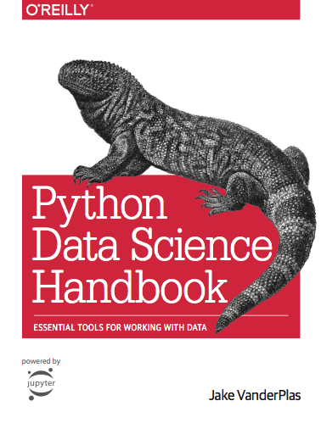
Reading Recommendation
https://jakevdp.github.io/PythonDataScienceHandbook/

Slide 6
Jupyter Notebook
Notebook has the ability to re-run individual snippets
In a notebook you can edit those snippets before re-running them.
Powerful tool for educational purposes as well as prototyping and testing.
However, would recommend using more advanced IDE’s for large project developments.
TO RUN A SINGLE CELL PRESS SHIFT + ENTER
You can find more shortcuts under Help -> Keyboard Shortcuts

Slide 7
NumPy Introduction
NumPy stands for Numerical Python.
Python itself is considered to have slow execution and so need a way to speed up some operations.
It is a core of almost every efficient programme you write in Python.
Hard to understand at times but extremely important to learn.
We are here to help you with this.

Slide 8
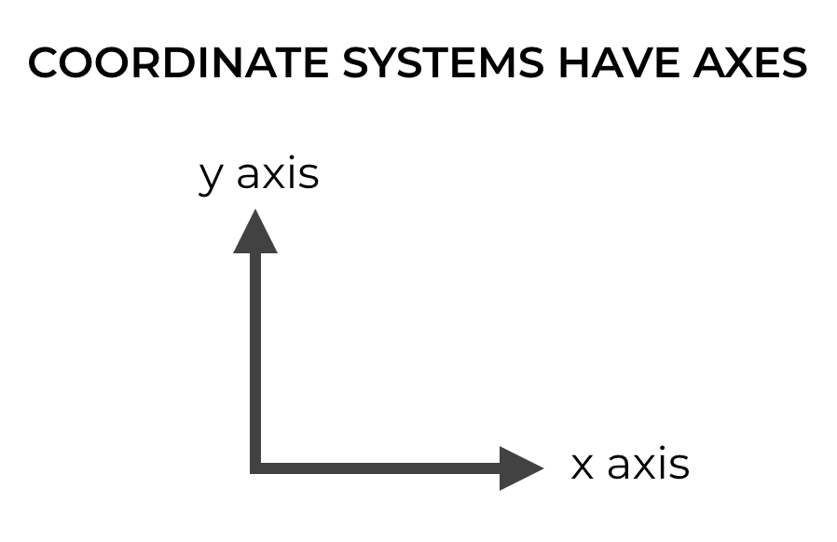
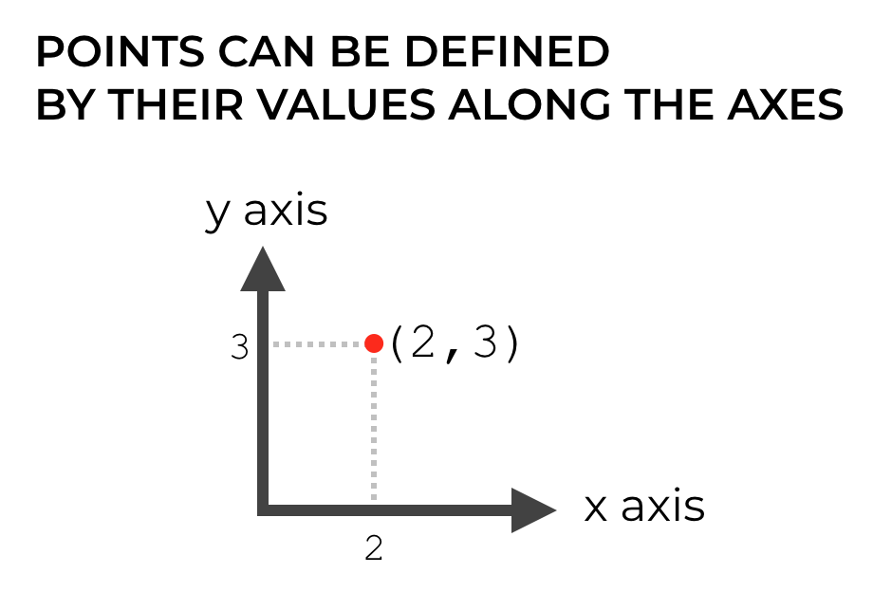
NumPy Axes

Slide 9
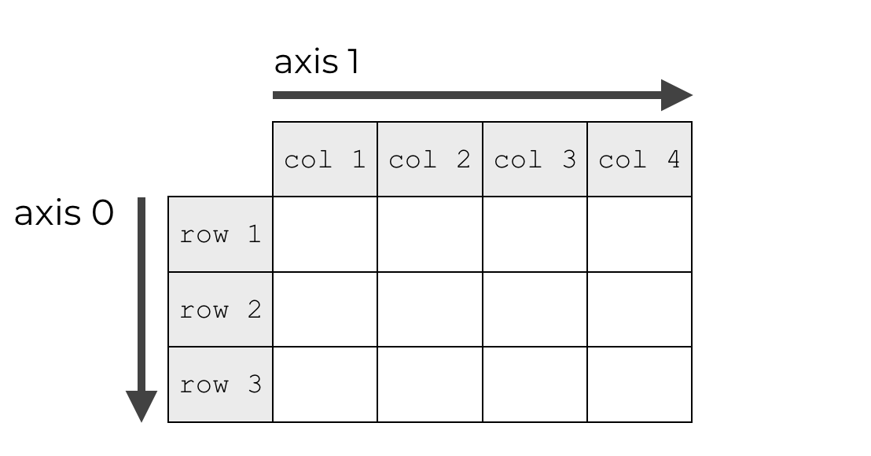
NumPy Axes

Slide 10
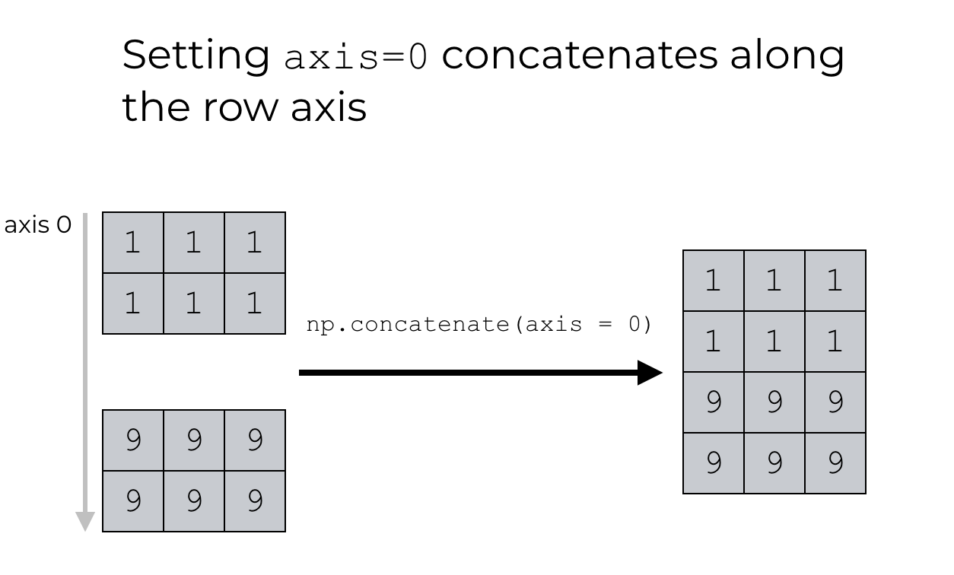
NumPy Concatenati

Slide 11
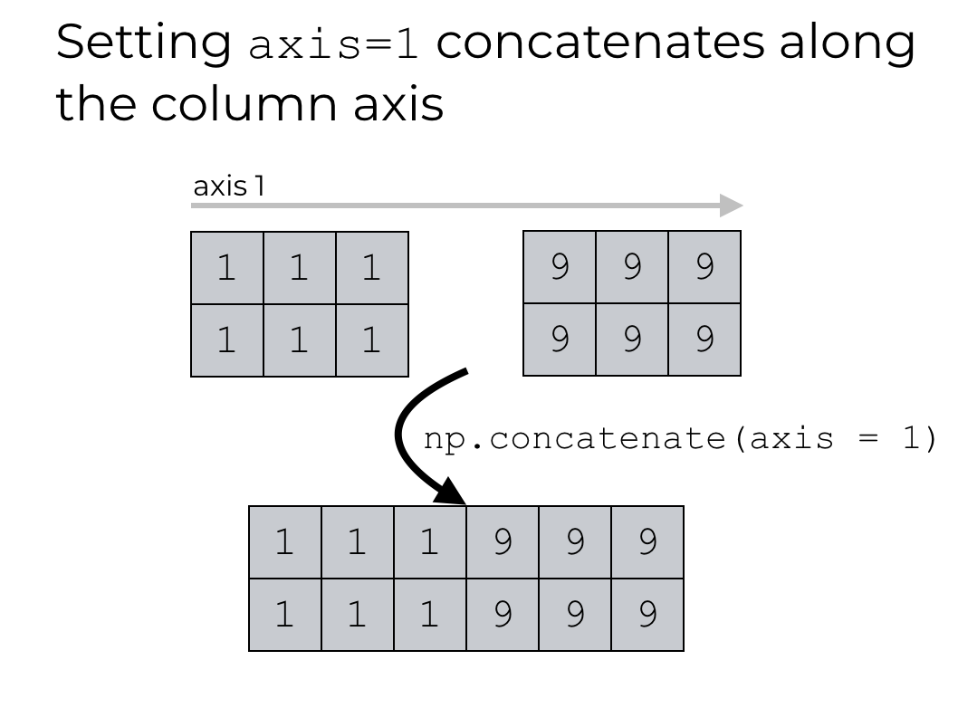
NumPy Concatenati

Slide 12
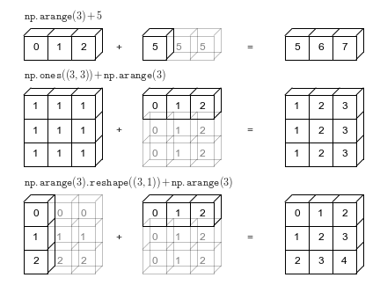
NumPy Broadcasting

Slide 13
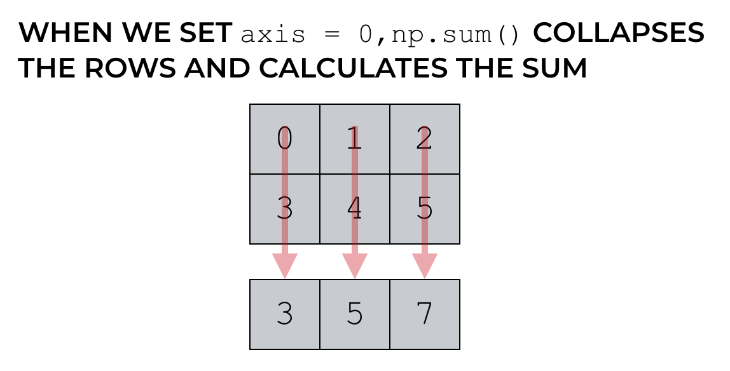
NumPy Aggregation

Slide 14
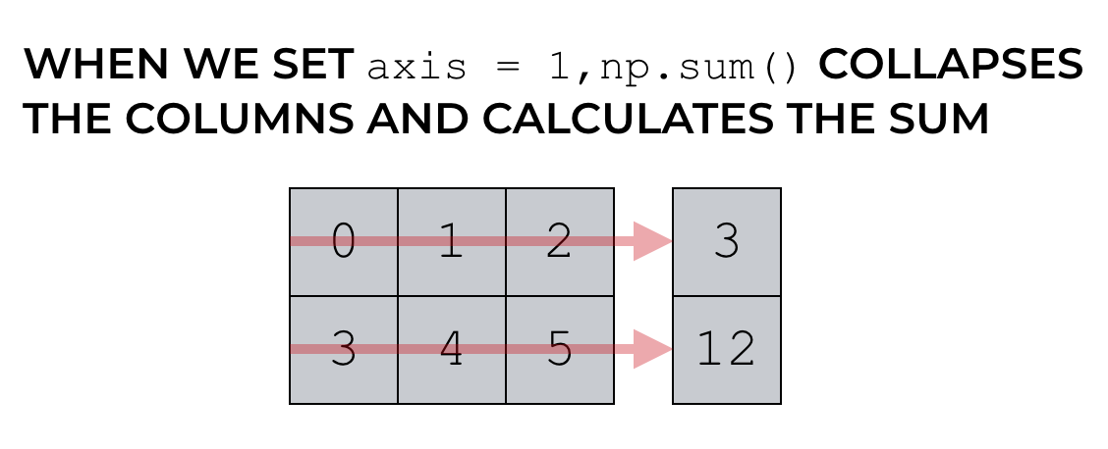
NumPy Aggregation

Slide 15
Pandas Introduction
bit.ly/python_pandas

Slide 16
Pandas Introduction
One of the key paradigms of Python is clear and understandable code.
In this sense Pandas is one of the most Pythonic libraries you will find out there.
It offers powerful, expressive and flexible data structures that make data manipulation and analysis easy.
Something that would take dozen of line of code in NumPy can be written in a few in Pandas.
Disadvantages? It is slower and you have to learn a load of new syntax…

Slide 17
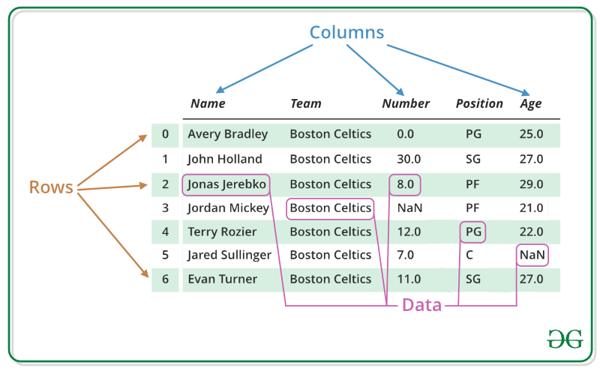
Pandas Data Structures

Slide 18
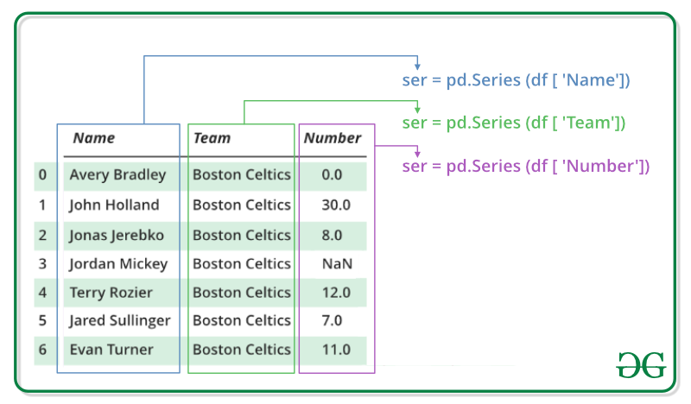
Pandas Data Structures

Slide 19
Pandas vs NumPy
Different syntax for accessing elements within the data structure.
The use of named columns make the code more readable
Similar aggregation functions. Try comparing the performance between the two libraries?
Pandas makes it much easier to perform large scale operations such as filling empty values or resampling the data set.
It is particularly useful when working with complicated Time Series data such as Stock Markets.

Slide 20
Matplotlib Introduction
bit.ly/python_matplotlib

Slide 21
Matplotlib Introduction
Plotting library that can be run on almost any machine
A core of many modern plotting tools such as Seaborn
Again, has a steep learning curve but important to understand its core functionality.

Slide 22
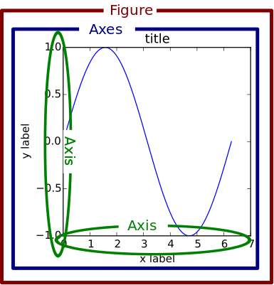
Matplotlib Hierarchy

Slide 23
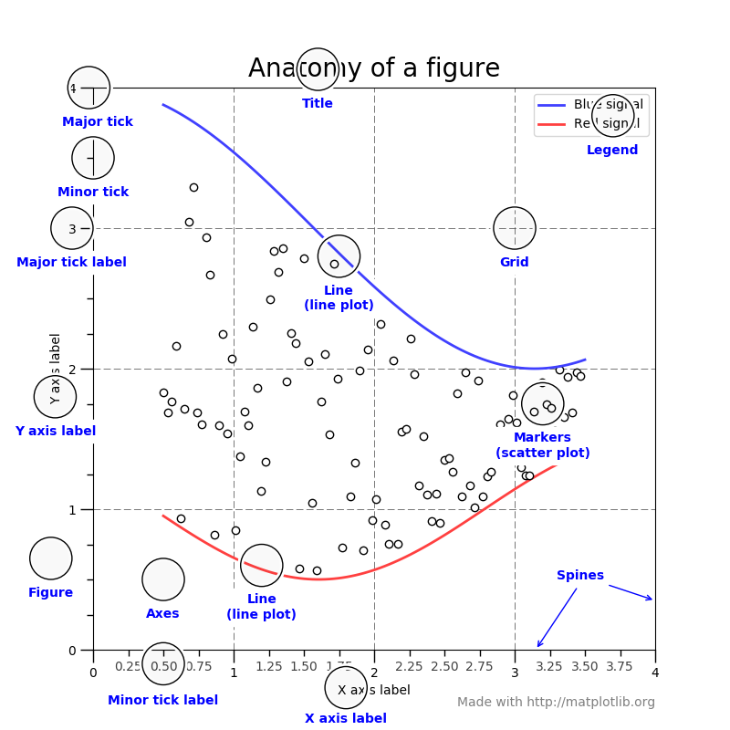
Matplotlib Hierarchy

Slide 24
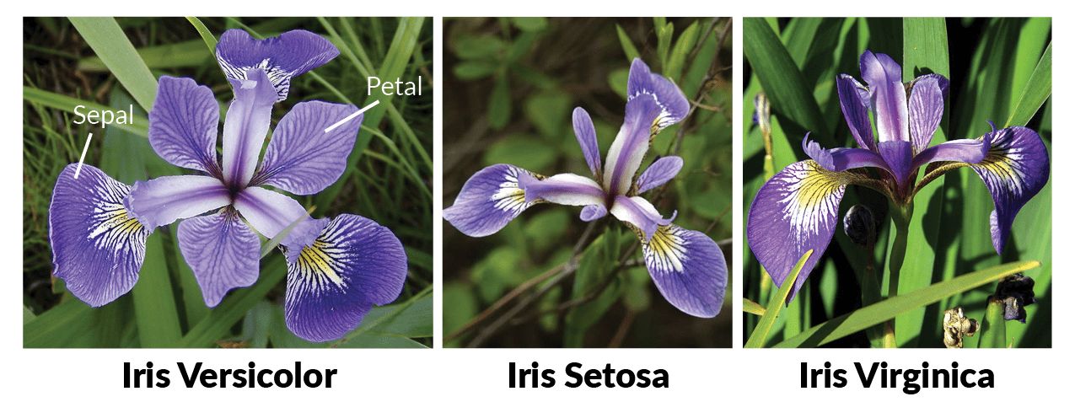
Iris Flower Dataset
The Iris flower data set or Fisher's Iris data set is a multivariate data set introduced by the British statistician and biologist Ronald Fisher in his 1936 paper The use of multiple measurements in taxonomic problems as an example of linear discriminant analysis.

